Slide 1
Weekly presentation
TESTING

Slide 2
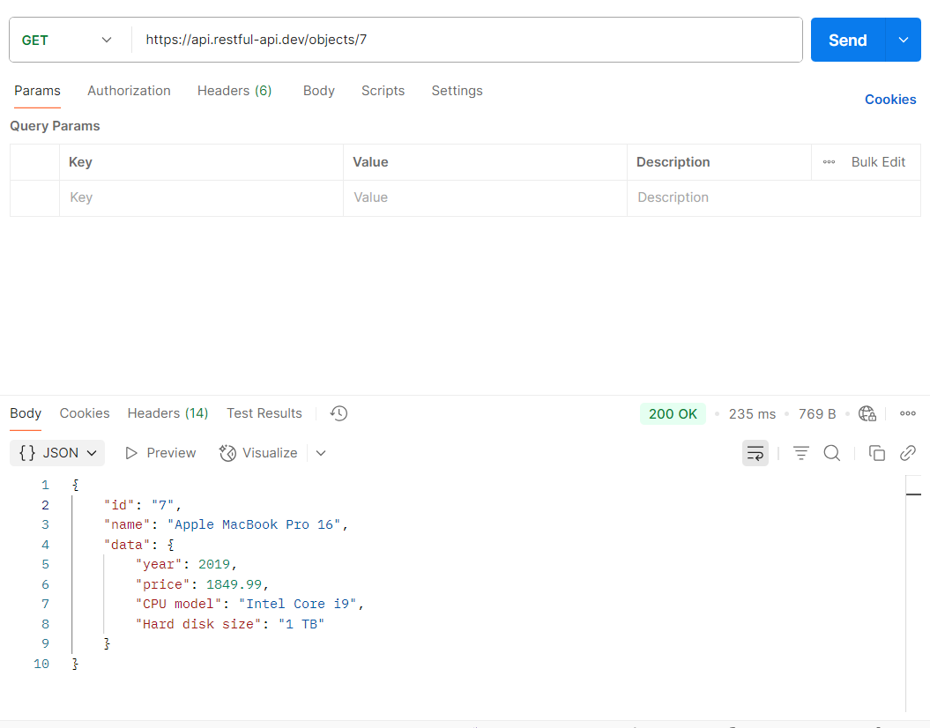
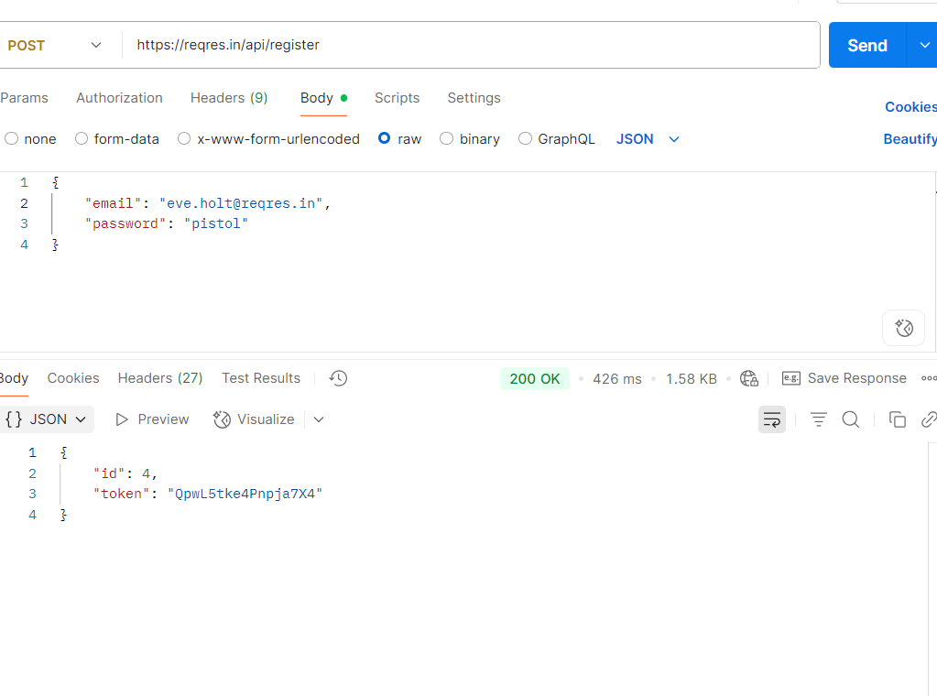
API TESTING
Some of the API’s are given below GET,POST

Slide 3
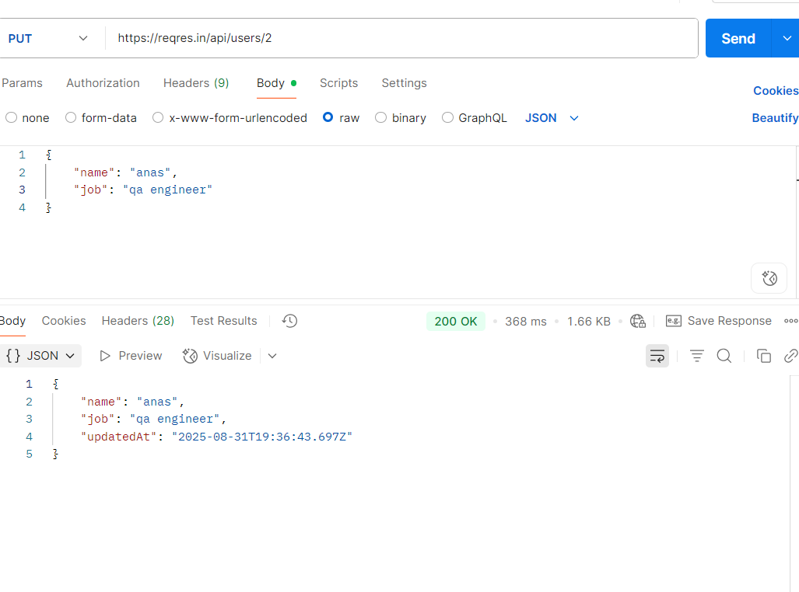
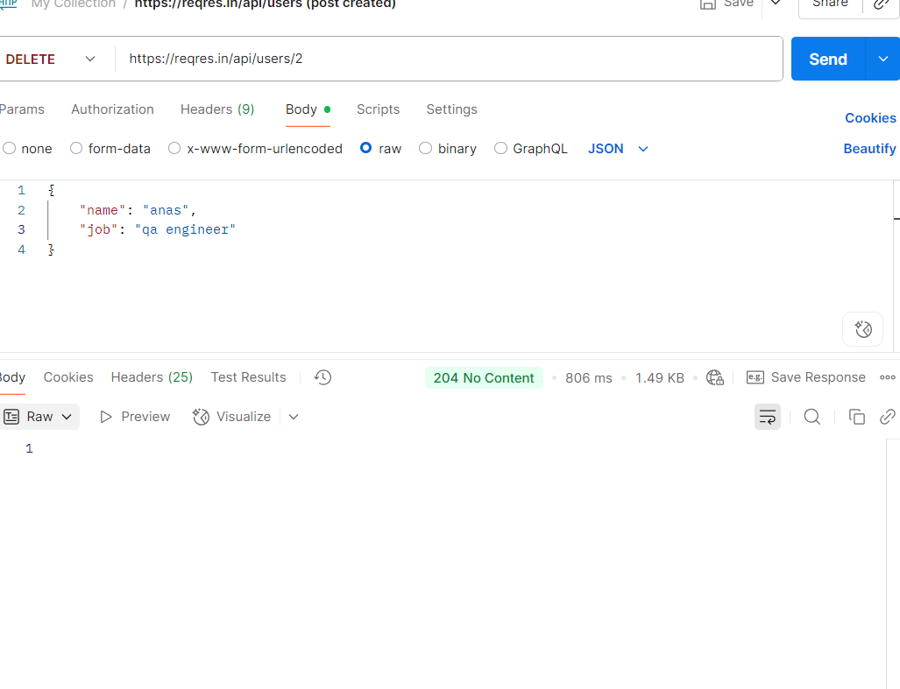
API TESTING
PUT,DELETE

Slide 4
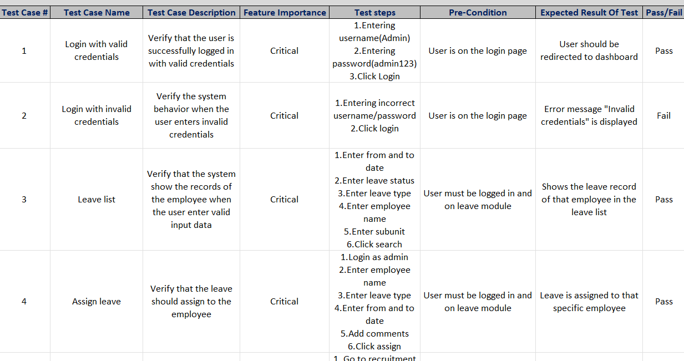
TEST CASES
I have tested 14 (9 pass and 5 fail) functionalities of orangeHRM include login, assign leave, apply for leave, add an employee and many more

Slide 5
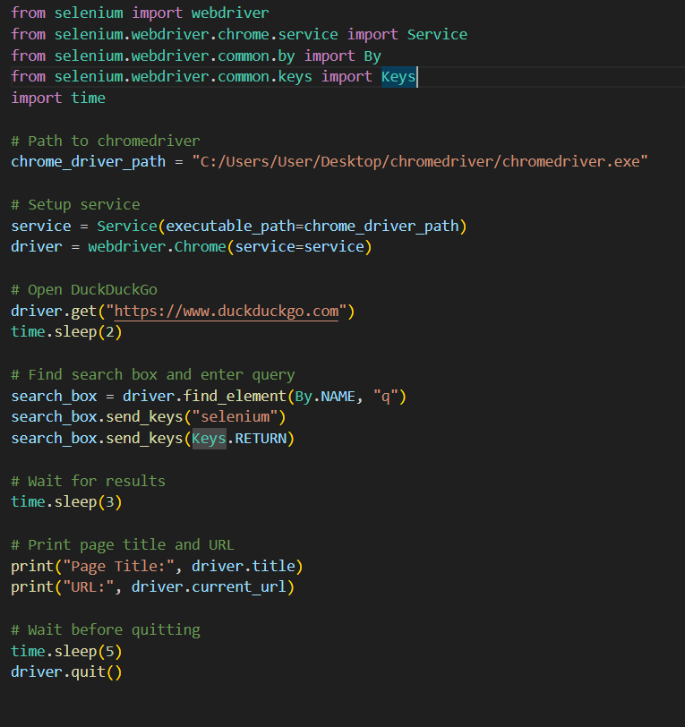
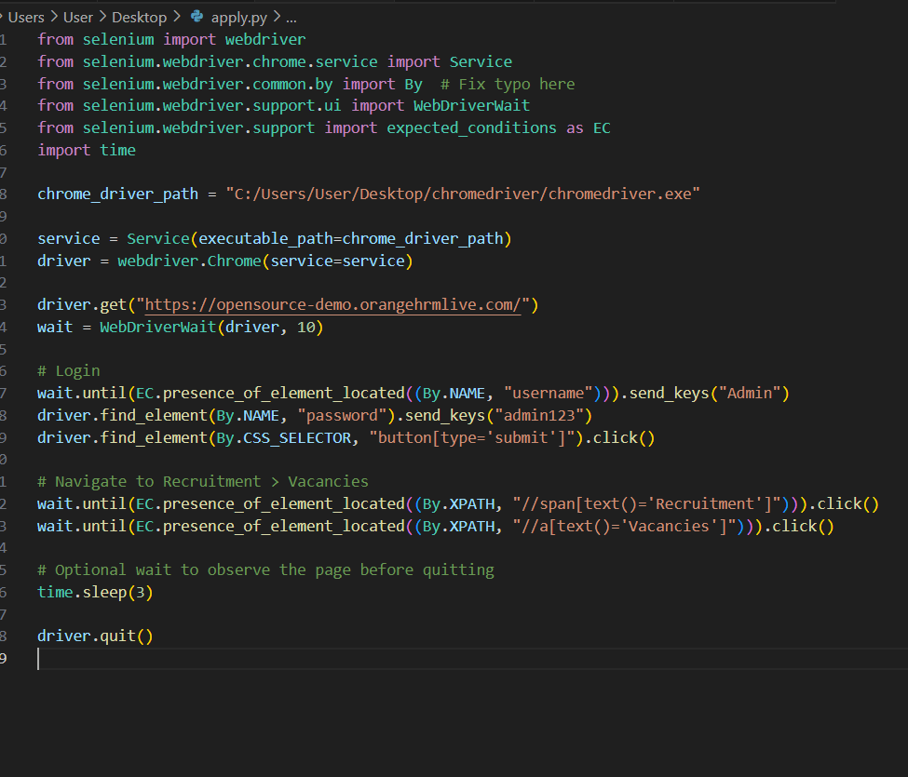
SELENIUM WITH PYTHON
For search functionality For apply functionality

Slide 6
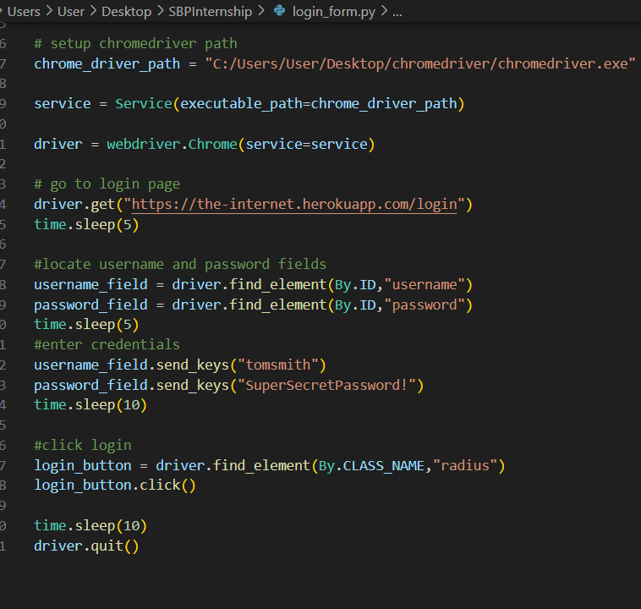
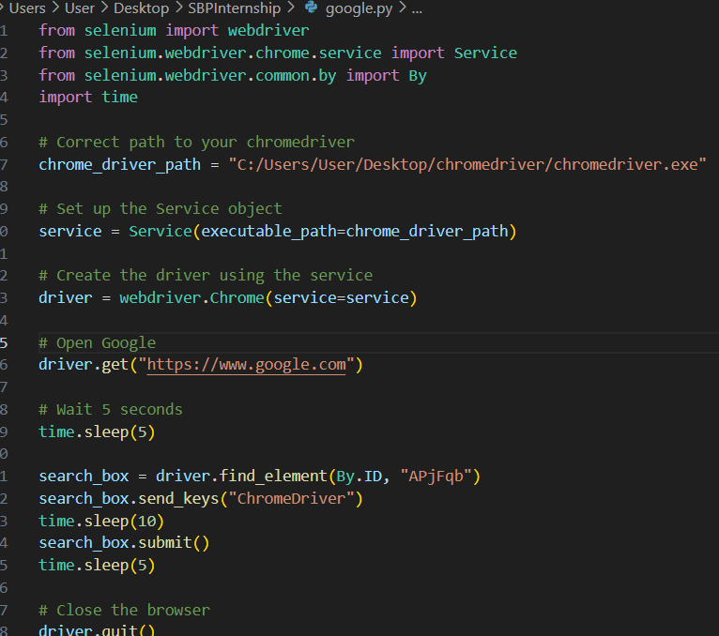
SELENIUM WITH PYTHON
For login functionality For opening google

